Slide 1
Introduction to Computer Science (371-1-1601)
Lectures by: Dr. Dan Vilenchik & Dr. Zion Siksik
Recitations by: Ariel Cohen, Moshiko Davidian, Assaf Livne, Yair Mazal

Slide 2
Recitation 6 Object Oriented Programming

Slide 3
Today’s topics
Dictionary recap
Class definition
Inheritance

Slide 4
Recap Exercise - BGU Student system
Build a dictionary that holds the student's name, phone number, grade sheet, and his current courses.
function to implement:
Enroll course
Add grade to course
Send email to student
Calculate average grade
Drop course

Slide 5
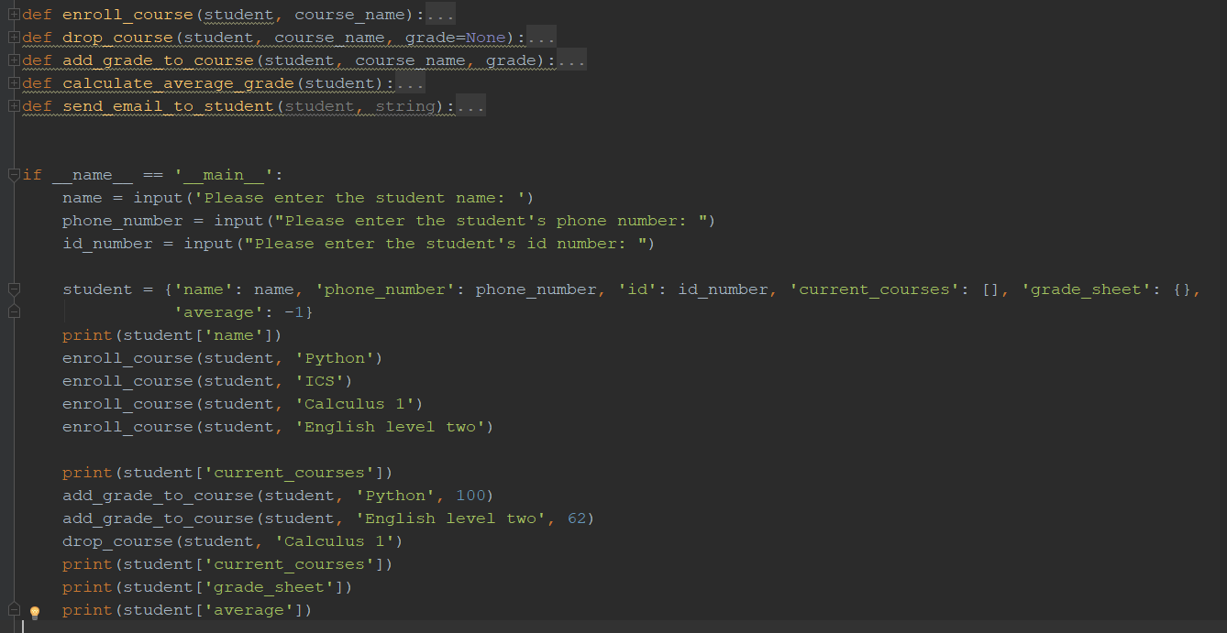
BGU Student system

Slide 6
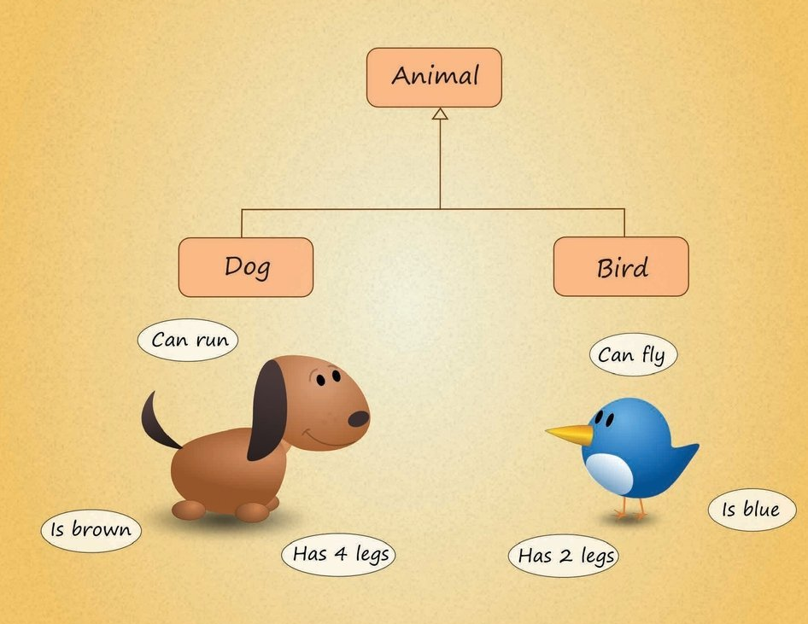
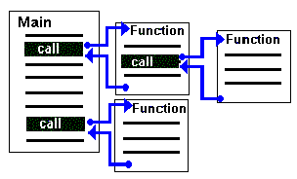
Classes
Procedural Programming
Object-Oriented Programming (OOP)

Slide 7
Object-Oriented Programming (OOP)
An object-oriented program may be viewed as a collection of interacting objects, as opposed to the conventional model, in which a program is seen as a list of tasks (subroutines) to perform. (from Wikipedia)
Objects holds both code (methods) and data (properties) for the entities they represent.

Slide 8
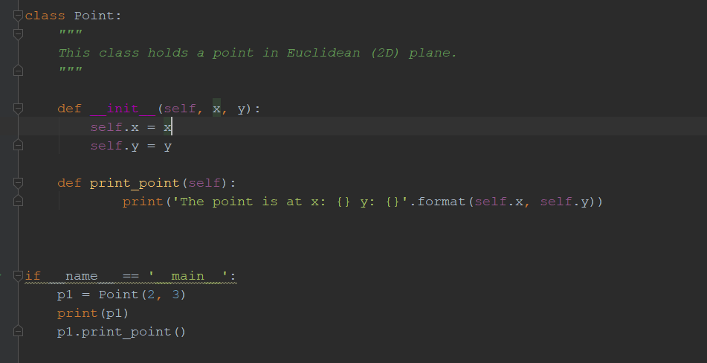
Example – class of Euclidian point

Slide 9
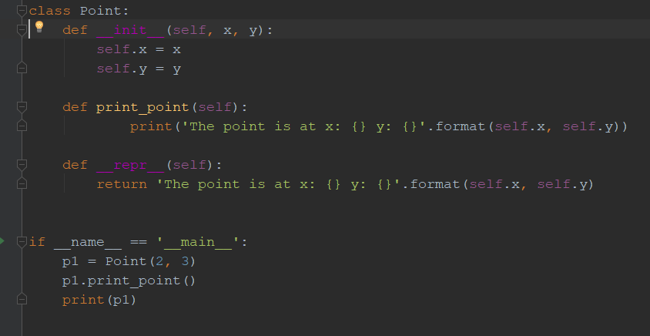
Example – class of Euclidian point

Slide 10
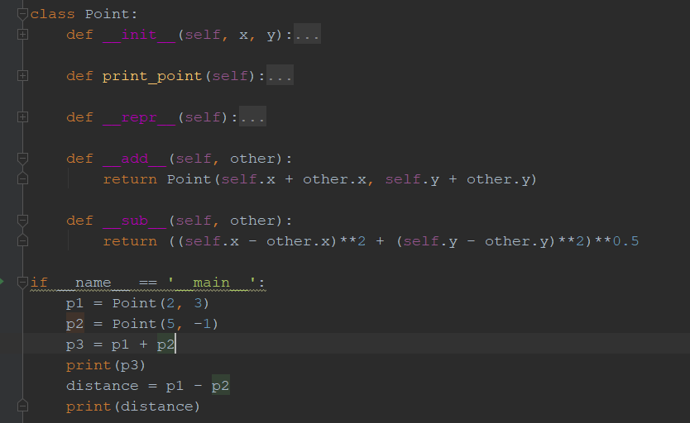
Example – class of Euclidian point

Slide 11
OOP Exercise 1 – class of student
Build a student class that holds the student's name, phone number, grade sheet, and his current courses.
Methods to implement:
Enroll course
Add grade to course
Send email to student
Calculate average grade
Drop course

Slide 12
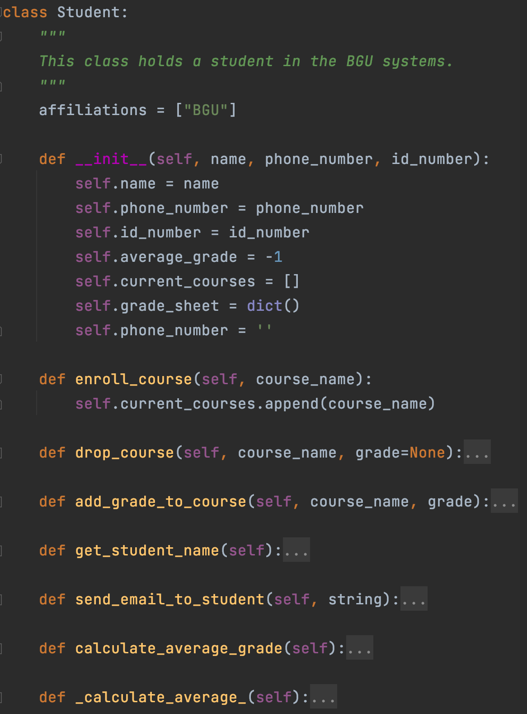
OOP Exercise 1 – class of student
Note that “affiliations” is a member of the class and not the instance (more on that later).
Thus, changing it for one object affects others too for mutable members.

Slide 13
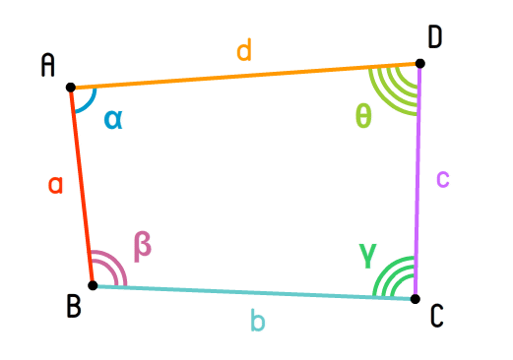
OOP Exercise 2 – quadrangle (מרובע)
Build a class for quadrangles.
Which properties does the quadrangle have?
Which methods should we implement?

Slide 14
OOP Exercise 2 – quadrangle
Properties
Methods
Points
Angles
Edges
Calculate area
Calculate perimeter
Calculate edges from points
Calculate angels from points

Slide 15
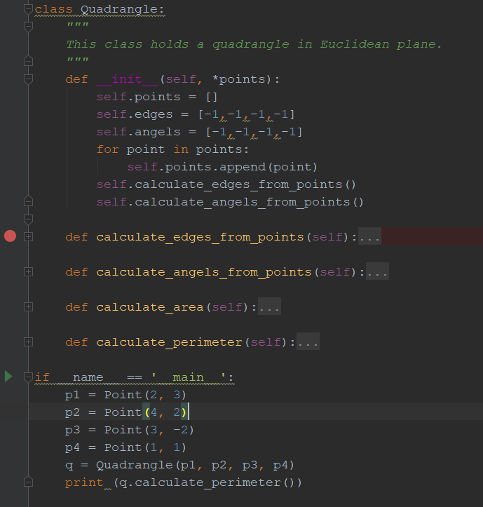
OOP Exercise 2 – quadrangle

Slide 16
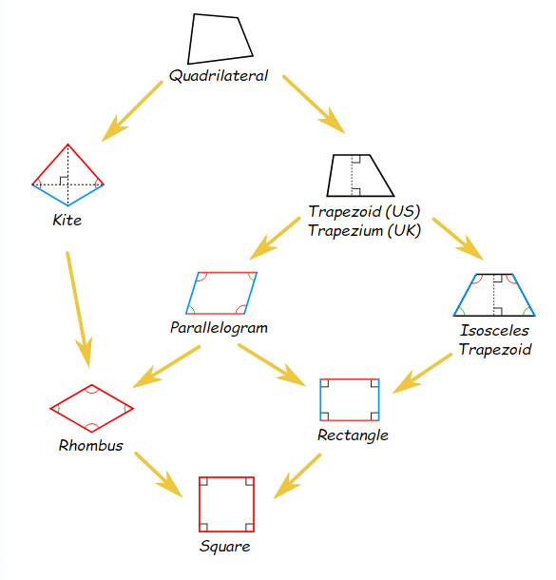
Inheritance
Class can inherit properties or methods from a father class
You can add new properties or methods to the child class
You can also override properties or methods of the father class

Slide 17
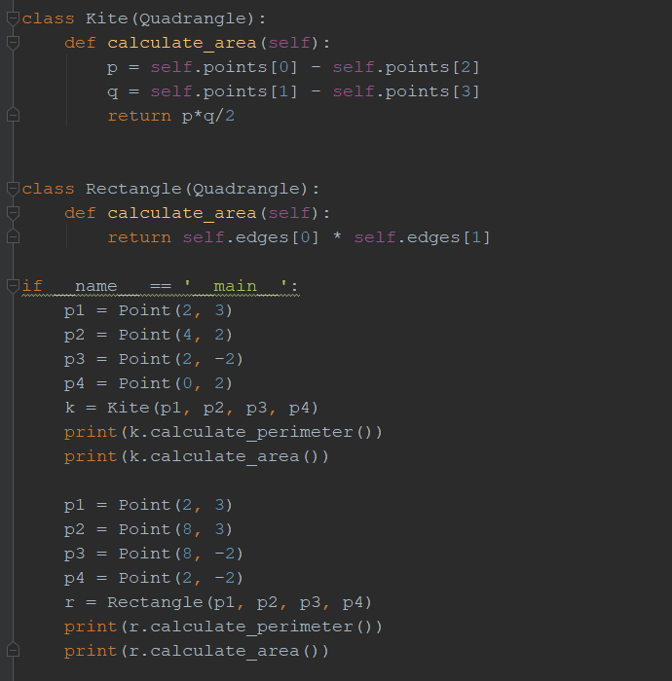
Kite (דלתון) and Rectangle (מלבן)

Slide 18
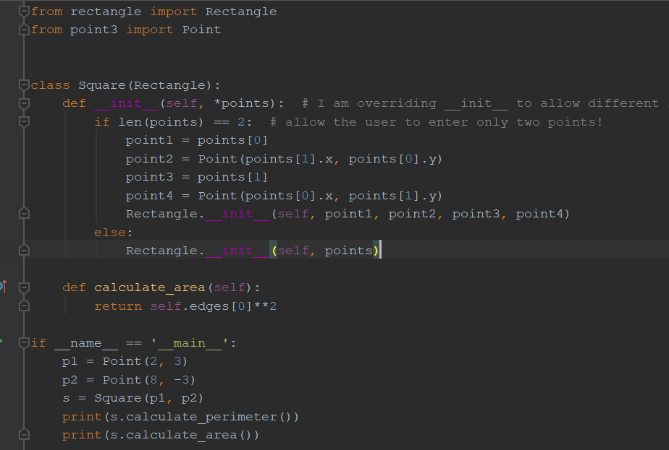
Square

Slide 19
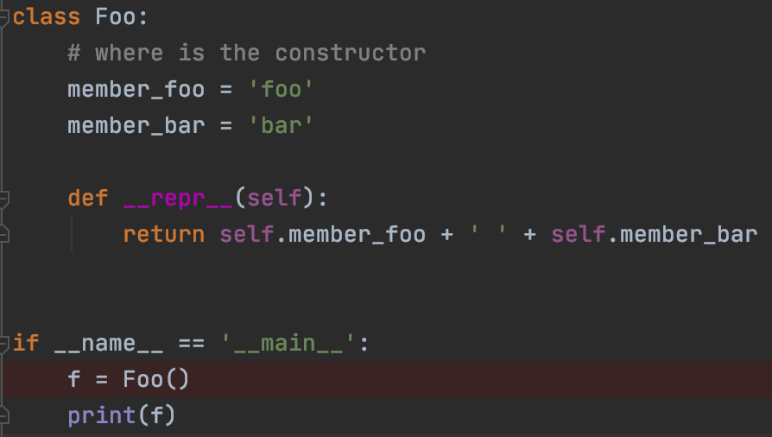
OOP – implicit constructor
Where is the constructor for Foo?
In python, if we don’t declare a constructor explicitly, python declares a defualt one for us.
The defualt constructor:
Allocates the object
Initializes defualt propoerties.

Slide 20

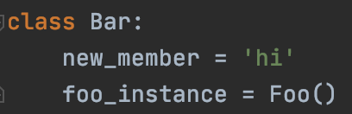

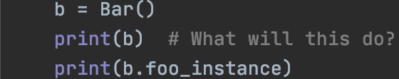
Recap - Inheritance vs. memebership
Inheritance
Membership
Subclass has access to parent methds
B is not an instance of Foo, no access to its methods, except via member

Slide 21
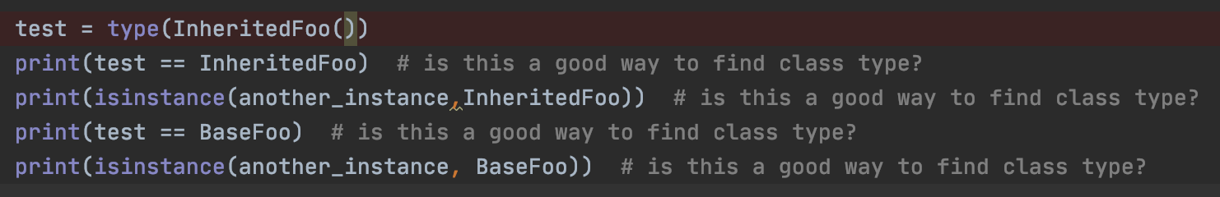
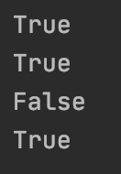
Python classes type testing
How can we check python classes types?
Unlike type() instance() preserves inheritance

Slide 22
OOP exercise - 3
Create a deck of cards class – Deck
The Deck class should have as members cards of type Card (another class).
Each card should have a suit (Hearts, Diamonds, Clubs, Spades) and a value (A,2,3,4,5,6,7,8,9,10,J,Q,K).
The Deck class should have a ”deal” method to deal a single card from the deck. After a card is dealt, it is removed from the deck.
There should be a ”shuffle” method which makes sure the deck of cards has all 52 cards and then rearranges them randomly.

Slide 23
Homework Assignment 2
The OOP aquarium

Slide 24
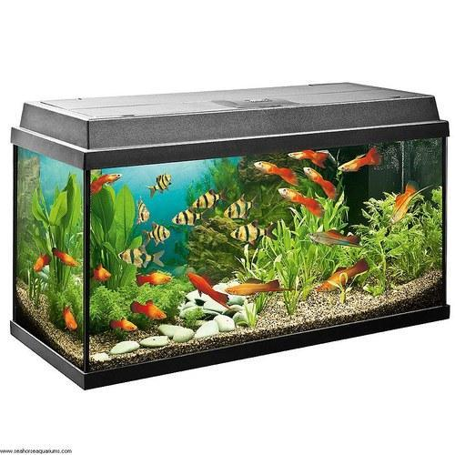
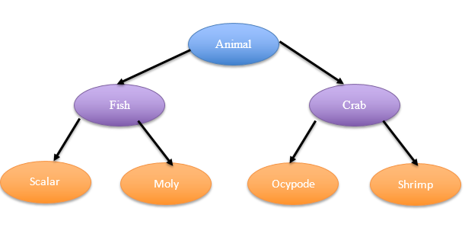
concept
You need to write a program that will display an aquarium.
The aquarium will include 4 types of animals, 2 types of fish and two types of crabs.
You should write the program based on the OOP principles you have learned.
The program will include a class for animals, a class for fish and a class for crabs. In addition, a class for each type.
In addition, a class for the aquarium.

Slide 25
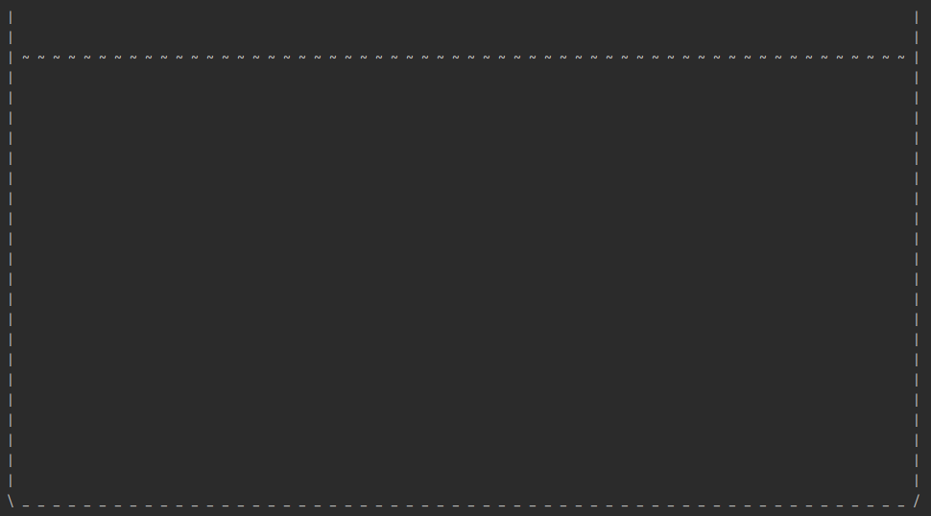
The aquarium
The aquarium class has several main methods:
constructor (including initial creation of the aquarium).
Print the aquarium to the screen.
Adding an animal to the aquarium.
Step progress (including animal swimming and data update).
Feeding the animals.
Print a list of all the animals in the aquarium.
Note: The aquarium drawing is the same as the background image (the size of the aquarium is not fixed)
You may add / divide into additional methods.

Slide 26
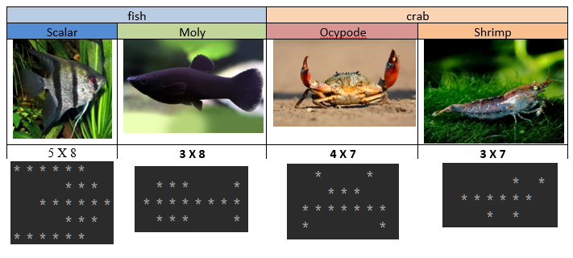
animals
The animals that swim in the aquarium are:
Fish - Scalar fish and Molly fish.
Crabs - Sand crab and shrimp.
Each of the animals is represented by * as seen in the picture.
Please note: the animals can swim in both directions and the head is always in the swimming direction.

Slide 27
animals
Main methods:
Swimming in the right direction:
Fish swim up or down and also right or left (swim diagonally).
Crabs move on the bottom of the aquarium right or left.
Remarks:
When an animal encounters the sides of the aquarium it changes direction (right / left).
The fish are afraid of the crabs, so they do not get close to the bottom. When a fish reaches the water line or near the bottom (detailed in the instructions) it changes the direction of its swimming (up / down).
When two crabs collide, they change their walking direction.
Fish are allowed to pass over each other (the aquarium is deep, and they swim at different depths).
Reducing the amount of food.
Increasing the age of the animal.

Slide 28
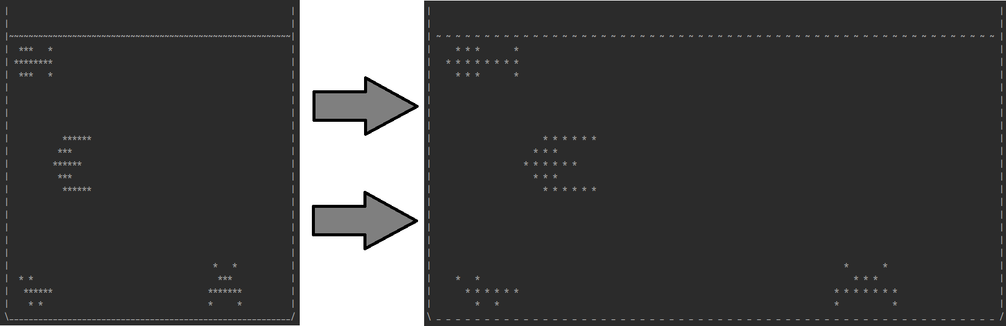
Screen printing
The size of the aquarium is determined by the user (with minimum values)
Screen printing is done with a space " " between any two horizontal characters:
Without space (‘ ‘)
With space (‘ ‘)

Slide 29
Remarks
In each step (turn / unit of time) each crab progresses one step horizontally and each fish one step horizontally and one step vertically (total one diagonal step).
When adding an animal the user enters a name, age, starting position and swimming direction. The initial amount of food is fixed.
An animal that has run out of food or reaches the age of 120 is dead.
Full instructions and requirements are in the homework file!

